Slide 1
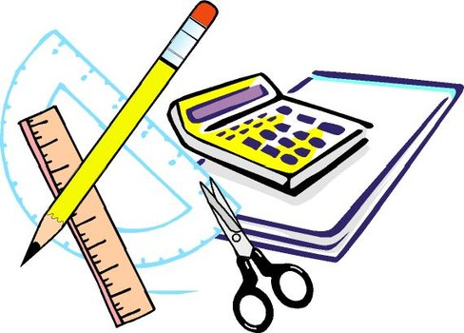
Learning Objective
I will calculate probabilities from tree diagrams
Enter quietly, please be ready with the following on your desk:
Whiteboard
Whiteboard marker
Exercise Book
Pencil, pen, ruler and red pen
Diary
Calculator
Device – charged or borrowed from Library before maths

Slide 2

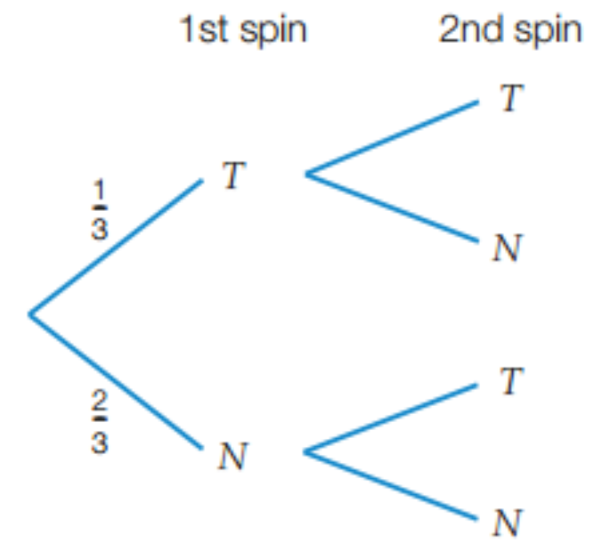
Daily Review
A spinner numbered 1 to 3 is spun twice. Let T represent the
spinner lands on 2 and N represent the spinner does not land on 2.
Draw a tree diagram that represents this situation
Find the probability of spinning 2 twice. c) Find the probability of spinning 2 once.
d) Find the probability of spinning 2 at least once. e) Find the probability of not spinning 2.
1/3
Pr(TT): 1/3 x 1/3 = 1/9
2/3
Pr(TN): 1/3 x 2/3 = 2/9
Pr(NT): 2/3 x 1/3 = 2/9
1/3
2/3
Pr(NN): 2/3 x 2/3 = 4/9

Slide 3
Daily Review
A spinner numbered 1 to 3 is spun twice. Let T represent the
spinner lands on 2 and N represent the spinner does not land on 2.
Draw a tree diagram that represents this situation
Find the probability of spinning 2 twice. c) Find the probability of spinning 2 once.
d) Find the probability of spinning 2 at least once. e) Find the probability of not spinning 2.
b) The probability of spinning 2 twice is
Pr(TT) = 1/9
Pr(TT) = 1/9
1/3
c) The probability of spinning 2 once is
Pr(TN) + Pr(NT): 2/9 + 2/9 = 4/9
Pr(TN) = 2/9
2/3
d) The probability of spinning 2 at least once is
Pr(TT) + Pr(TN) + Pr(NT): 1/9 + 2/9 + 2/9 = 5/9
Pr(NT) = 2/9
1/3
e) The probability of not spinning 2 is
Pr(NN) = 4/9
Pr(NN) = 4/9
2/3

Slide 4
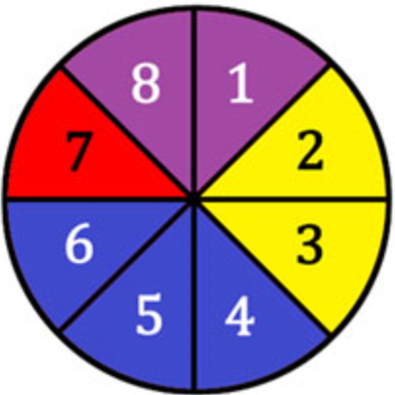
Learning Objective
CFU 1
What will we learn?
I will calculate probabilities from tree diagrams.
CFU 2
What will we learn?
Success Criteria
I will be able to list sample spaces.
I will be able to calculate probabilities of multiple events.
I will be able to interpret tree diagrams.
I will be able to calculate probabilities of multiple events that
are not equally likely, with and without replacement.

Slide 5
Activate Prior Knowledge
A marble is taken from a bag containing 4 blue marbles and 7 green marbles. It is replaced and then a 2nd marble is taken out.
Draw a tree diagram that represents this situation
Find the probability of getting two green marbles.
Find the probability of getting at least one blue marble.
‘with replacement’
<
1st
2nd
b) The probability of 2 greens is
Pr(GG) = 49/121.
<
B
4/11
Pr(BB): 4/11 x 4/11 = 16/121
4/11
B
<
G
7/11
Pr(BG): 4/11 x 7/11 = 28/121
B
c) The probability of at least 1 blue is
Pr(BB) + Pr(BG) + Pr(GB):
16/121 + 28/121 + 28/121
= 72/121
4/11
Pr(GB): 7/11 x 4/11 = 28/121
7/11
G
7/11
G
Pr(GG): 7/11 x 7/11 = 49/121

Slide 6
Concept Development
A marble is taken from a bag containing 4 blue marbles and 7 green marbles. It is not replaced before a 2nd marble is taken out.
Draw a tree diagram that represents this situation
‘without replacement’
<
1st
2nd
<
B
After we take one marble out, there are only 10 marbles left.
If the 1st marble was blue, there are only 3 blue marbles left.
If the 1st marble was blue, there are still 7 green marbles left.
3/10
4/11
B
<
G
7/10
B
4/10
If the 1st marble was green, there are still 4 blue marbles left.
If the 1st marble was green, there are only 6 green marbles left.
7/11
G
6/10
G

Slide 7
Skill Development
A marble is taken from a bag containing 4 blue marbles and 7 green marbles. It is not replaced before a 2nd marble is taken out.
a) Draw a tree diagram that represents this situation.
b) Find the probability of getting two green marbles.
c) Find the probability of getting at least one blue marble.
‘without replacement’
<
1st
2nd
b) The probability of 2 greens is
Pr(GG) = 21/55
<
B
3/10
Pr(BB): 4/11 x 3/10 = 6/55
4/11
B
<
G
7/10
Pr(BG): 4/11 x 7/10 = 14/55
B
c) The probability of at least 1 blue is
Pr(BB) + Pr(BG) + Pr(GB)
= 6/55 + 14/55 + 14/55
= 34/55
4/10
Pr(GB): 7/11 x 4/10 = 14/55
7/11
G
6/10
G
Pr(GG): 7/11 x 6/10 = 21/55

Slide 8
Guided Practice
Two cards are drawn, without replacement, from a set of 20 cards that are numbered 1 to 20.
Let P = ‘a prime number is drawn’ and N = ‘a prime number is not drawn’.
Draw a tree diagram to show this information.
Prime numbers between 1 and 20 are 2, 3, 5, 7, 11, 13, 17, 19 (eight in total).
<
1st
2nd
<
P
After we take one card, there are only 19 cards left.
If the 1st card was prime, there are only 7 primes left.
If the 1st card was prime, there are still 12 non-primes left.
7/19
8/20
P
<
N
12/19
P
8/19
12/20
N
If the 1st card wasn’t prime, there are still 8 primes left.
If the 1st card wasn’t prime, there are only 11 non-primes left.
11/19
N

Slide 9
Guided Practice
Two cards are drawn, without replacement, from a set of 20 cards that are numbered 1 to 20.
Let P = ‘a prime number is drawn’ and N = ‘a prime number is not drawn’.
Find Pr(both cards are prime)
Find Pr(no cards are prime)
Find Pr(at least one card is prime)
<
a) Pr(both prime) is
Pr(PP) = 14/95.
1st
2nd
<
P
7/19
Pr(PP): 8/20 x 7/19 = 14/95
b) Pr(no primes) is
Pr(NN) = 33/95.
8/20
P
<
N
12/19
Pr(PN): 8/20 x 12/19 = 24/95
P
c) Pr(at least 1 prime) is
Pr(PP) + Pr(PN) + Pr(NP)
= 14/95 + 24/95 + 24/95
= 62/95
8/19
Pr(NP): 12/20 x 8/19 = 24/95
12/20
N
11/19
N
Pr(NN): 12/20 x 11/19 = 33/95

Slide 10
Independent Practice
Mathspace – Year 10 Mainstream Tree Diagrams
Without Replacement CLASS WORK
<
1st
2nd
b) The probability of 2 greens is
Pr(GG) = 21/55
<
B
3/10
Pr(BB): 4/11 x 3/10 = 6/55
4/11
B
<
G
7/10
Pr(BG): 4/11 x 7/10 = 14/55
B
c) The probability of at least 1 blue is
Pr(BB) + Pr(BG) + Pr(GB)
= 6/55 + 14/55 + 14/55
= 34/55
4/10
Pr(GB): 7/11 x 4/10 = 14/55
7/11
G
6/10
G
Pr(GG): 7/11 x 6/10 = 21/55

